Slide 1
Types of angles
Miss L
Year 7

Slide 2
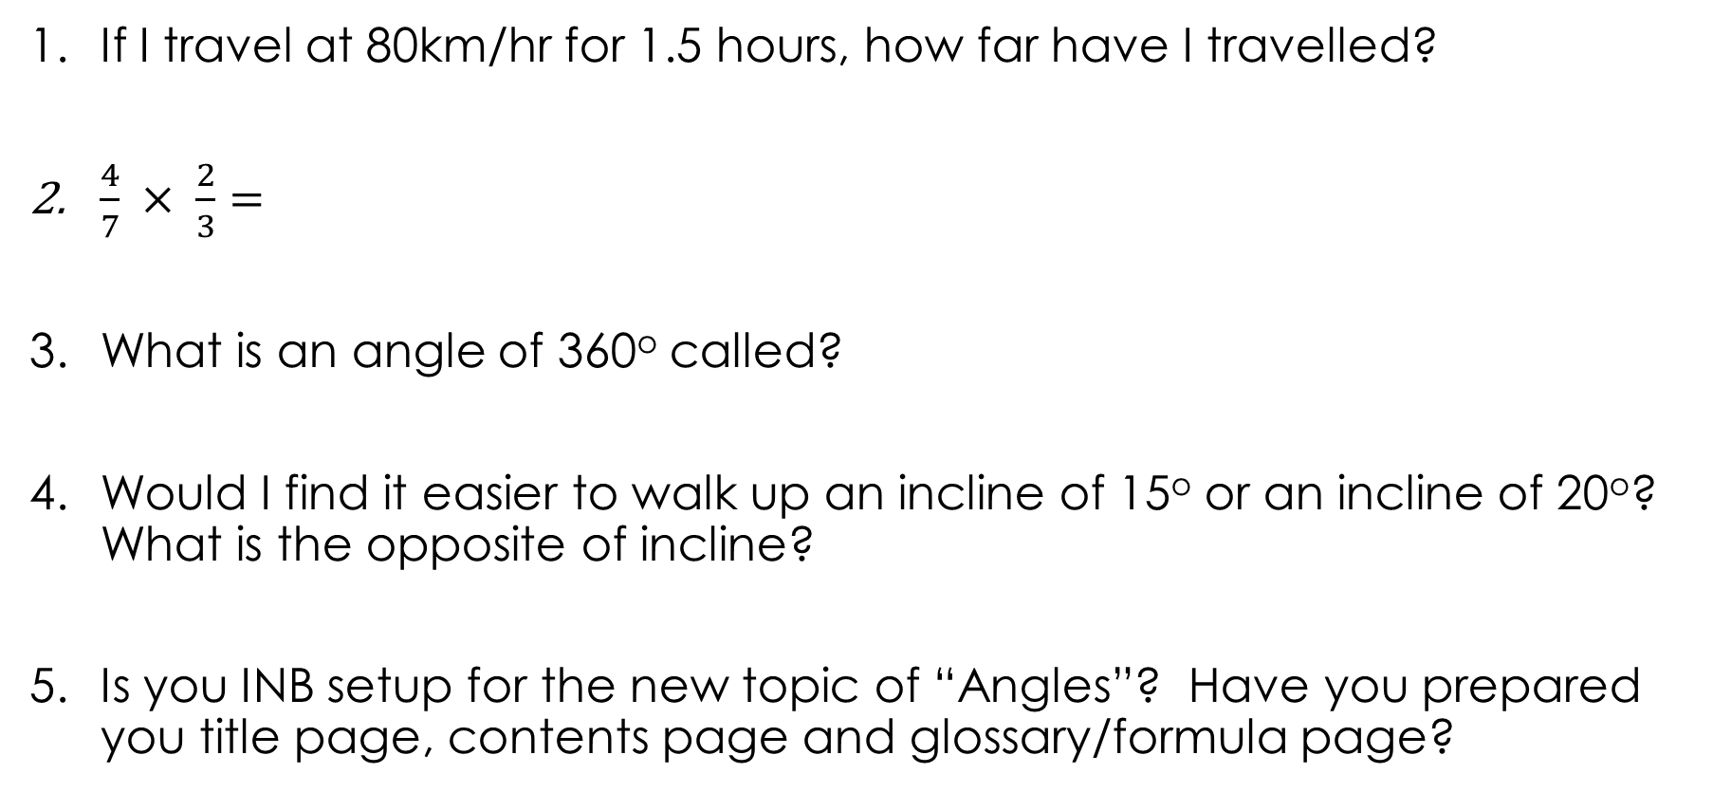
5 Questions
If I travel at 80km/hr for 1.5 hours, how far have I travelled?
$\frac{4}{7} × \frac{2}{3}=$
What is an angle of 360º called?
Would I find it easier to walk up an incline of 15º or an incline of 20º? What is the opposite of incline?
Is you INB setup for the new topic of “Angles”? Have you prepared you title page, contents page and glossary/formula page?

Slide 3
Learning Intentions
Students will be able to
Label the 6 types of angles
Learn how to use a protractor

Slide 4

Think-pair-share
Think
  What do you think an angle is?
  How many types of angles can you name?
Pair
  Share your answers with the person next to you.
Share
  Put your hand up to share your answers with the class.
Notes:
Guide students through the question.
Option 2: Dot plots handout (Scaffolded for kids who may need extra help)

Slide 5
https://www.youtube.com/watch?v=bDgUTsNr4oc
Notes:
Start around 3mins 20 seconds – finish at 5:20

Slide 6
24
7
30
Topic: Type of Angles
Date:
EQ – What are the different types of angles and how do I measure them?
What does an Angle look like?
Arm
Angle
Vertex
Arm
The amount of space between two straight lines. Measured in degrees.
Example: 45°
What is an Angle?

Slide 7
24
7
30
Topic: Type of Angles
Date:
EQ – What are the different types of angles and how do I measure them?
What does an Angle look like?
A
G
B
We can use letters to name an angle. The angle above can be named in 2 ways.
∠AGB or ∠G
Sign means angle
This can only be used if there is only one angle at vertex “G”
Middle letter must the be the vertex

Slide 8


Slide 9
Complete the following in your Graphic Organiser
Once complete, glue it in your notebook

Slide 10
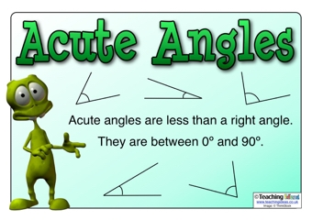
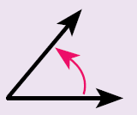
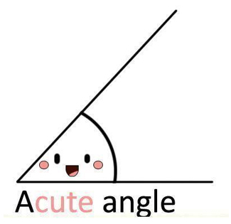
Acute angle
Name: Acute angle
Size: less than 90°
Diagram:
Notes:
Guide students through the question.
Option 2: Dot plots handout (Scaffolded for kids who may need extra help)

Slide 11
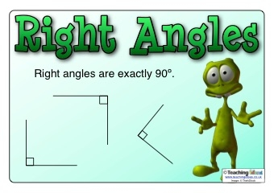
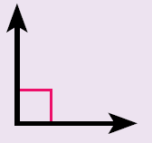
Right angle
Name: Right angle
Size: exactly 90°
Diagram:
That means it’s a right angle
A right angle is a quarter turn
Notes:
Guide students through the question.
Option 2: Dot plots handout (Scaffolded for kids who may need extra help)

Slide 13
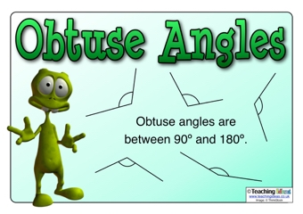
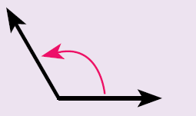
Obtuse angle
Name: Obtuse angle
Size: between 90° and 180 °
Diagram:
Notes:
Guide students through the question.
Option 2: Dot plots handout (Scaffolded for kids who may need extra help)

Slide 14
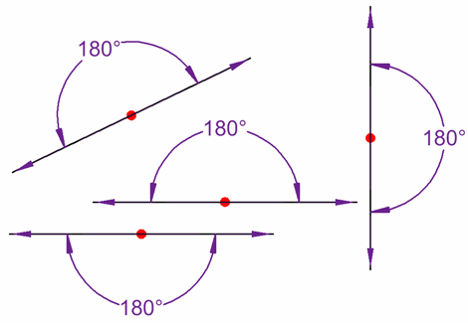
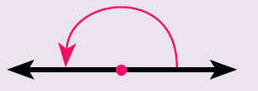
straight angle
Name: Straight angle
Size: exactly 180°
Diagram:
A straight angle is a half turn
Notes:
Guide students through the question.
Option 2: Dot plots handout (Scaffolded for kids who may need extra help)

Slide 15
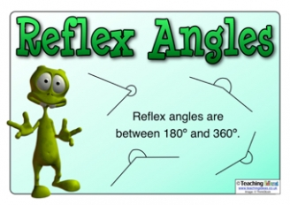
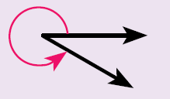
reflex angle
Name: Reflex angle
Size: between 180° and 360°
Diagram:
Notes:
Guide students through the question.
Option 2: Dot plots handout (Scaffolded for kids who may need extra help)

Slide 16
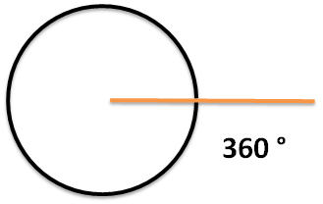
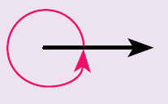
revolution angle
Name: Revolution angle
Size: exactly 360°
Diagram:
A revolution angle is one complete turn
Notes:
Guide students through the question.
Option 2: Dot plots handout (Scaffolded for kids who may need extra help)

Slide 18
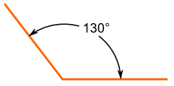
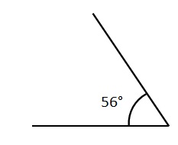
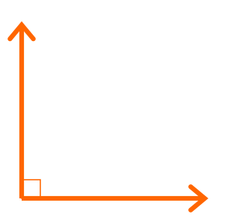

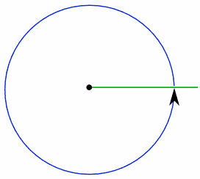
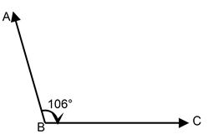
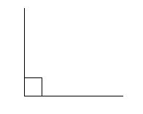
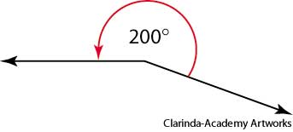
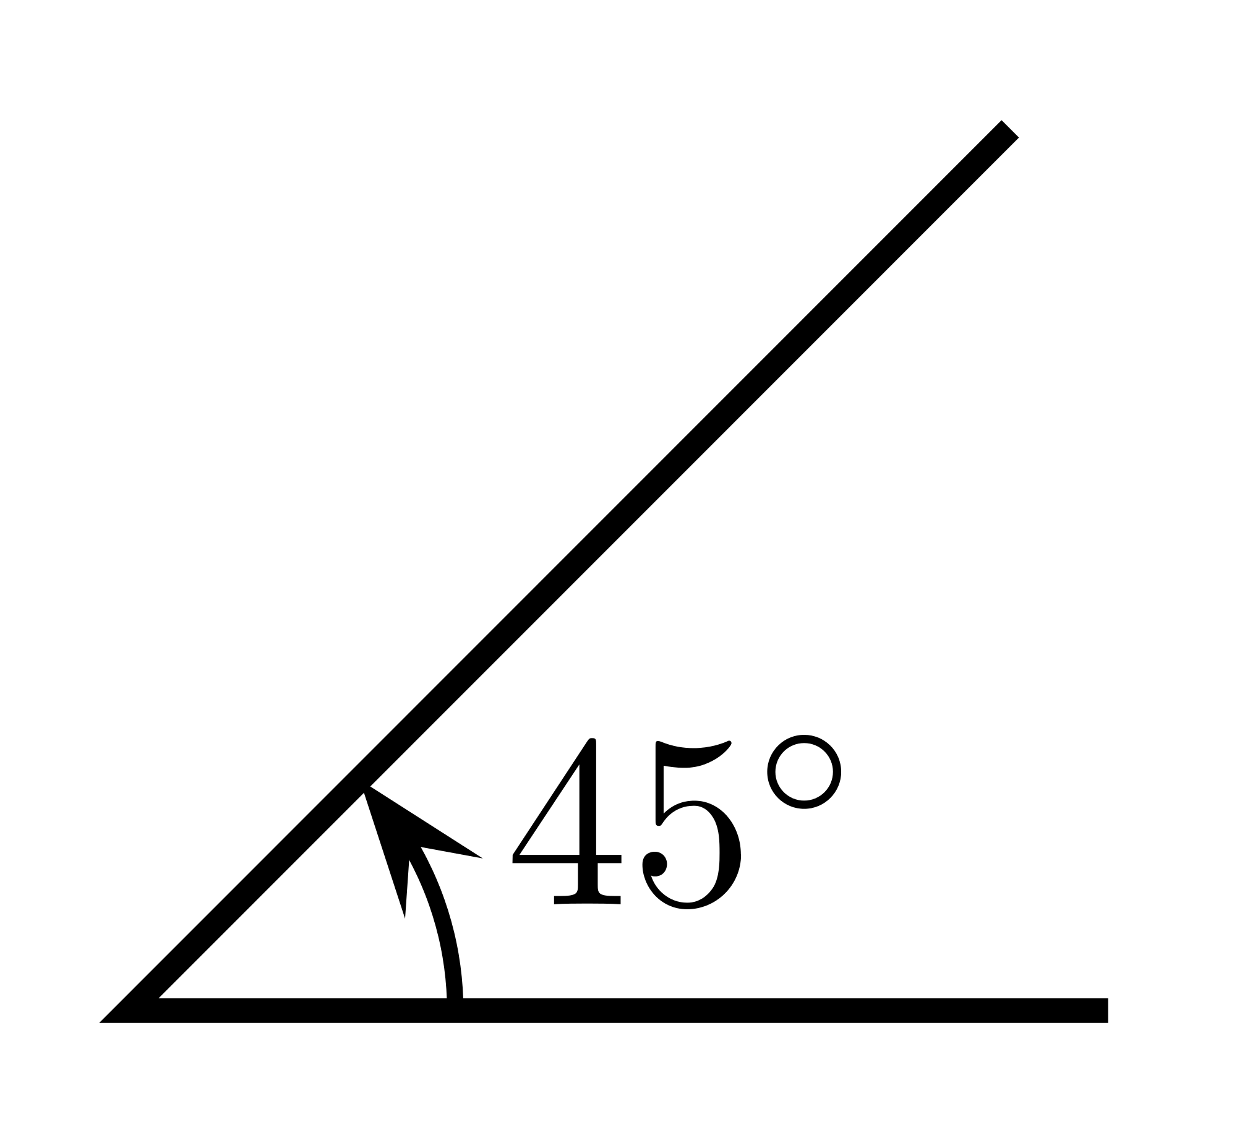
Practice
Which angle is which?!
Notes:
Guide students through the question.
Option 2: Dot plots handout (Scaffolded for kids who may need extra help)

Slide 19
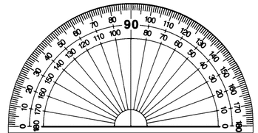
24
7
30
Topic: Type of Angles
Date:
EQ – What are the different types of angles and how do I measure them?
How to measure angles?
We use a nifty device called a protractor!

Slide 20
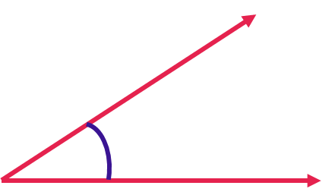
24
7
30
Topic: Type of Angles
Date:
EQ – What are the different types of angles and how do I measure them?
How to measure angles?
Step 1: Line up the bottom of the angle with the straight line of the protractor.

Slide 21
24
7
30
Topic: Type of Angles
Date:
EQ – What are the different types of angles and how do I measure them?
How to measure angles?
Step 2: Measure from the bottom arm to the top arm of the angle
Make sure the vertex is lined up with the middle of the protractor

Slide 22
24
7
30
Topic: Type of Angles
Date:
EQ – What are the different types of angles and how do I measure them?
How to measure angles?
Step 3: Read the protractor = 31°

Slide 23
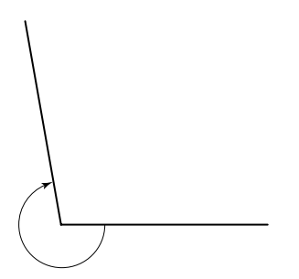
24
7
30
Topic: Type of Angles
Date:
EQ – What are the different types of angles and how do I measure them?
How to measure reflex angles?
Step 1: Measure the inside angle
Inside angle = 100°
Step 2: Reflex angle = 360 – 100
= 260°
Inside acute angle

Slide 24
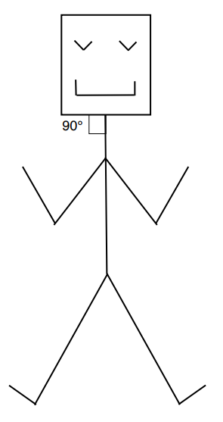
Practice
Stickman Angles Worksheet
Find and label as many angles as you can on the stickmen
Complete your summery!
Notes:
Guide students through the question.
Option 2: Dot plots handout (Scaffolded for kids who may need extra help)

